Slide 1

Will you help drive change?

Slide 2
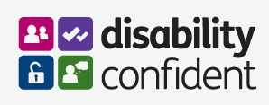
Disability Confident is creating a movement of change.
Our aim is to encourage employers to think differently about disability by taking action to improve their recruitment and to retain and develop existing disabled employees.

Slide 3


Slide 4

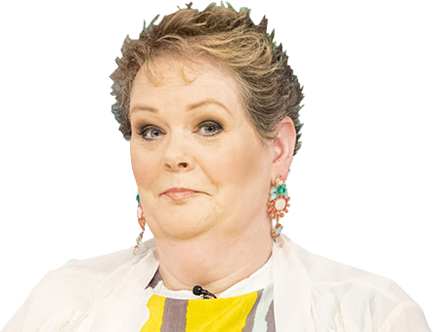
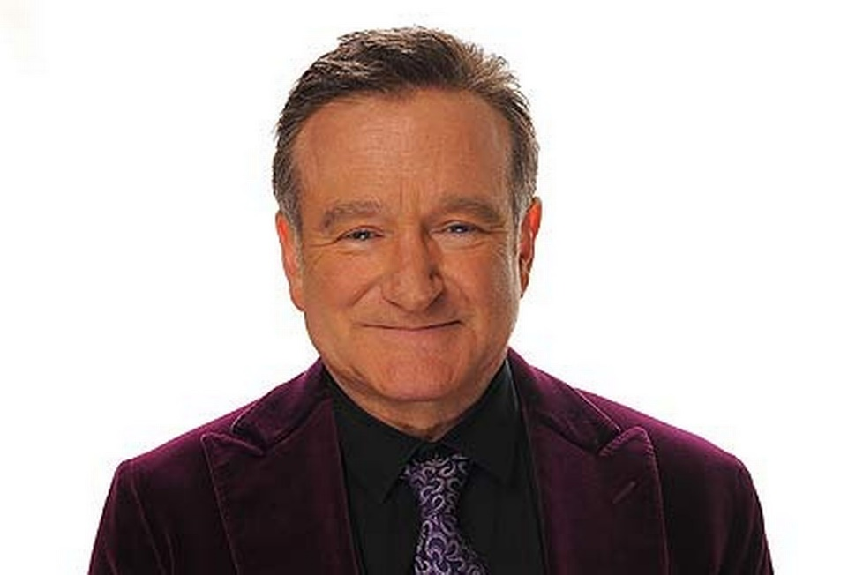
Q. What do these 3 famous people have in common?
Daniel Radcliffe
Anne Hegarty
Robin Williams

Slide 5
A. They ALL have hidden disabilities.
Robin Williams
Suffered from Attention Deficit Hyperactivity Disorder (ADHD) and dementia
Daniel Radcliffe
Suffers from dyspraxia which sometimes means he can’t tie shoelaces
Anne Hegerty
Anne has autism and Asperger’s

Slide 6
Real world example 1
Channel 4 is one of our Disability Confident Level 3 Leaders. This is the top level of employer sign up.
Let’s listen to what they do and how they help other businesses

Slide 7
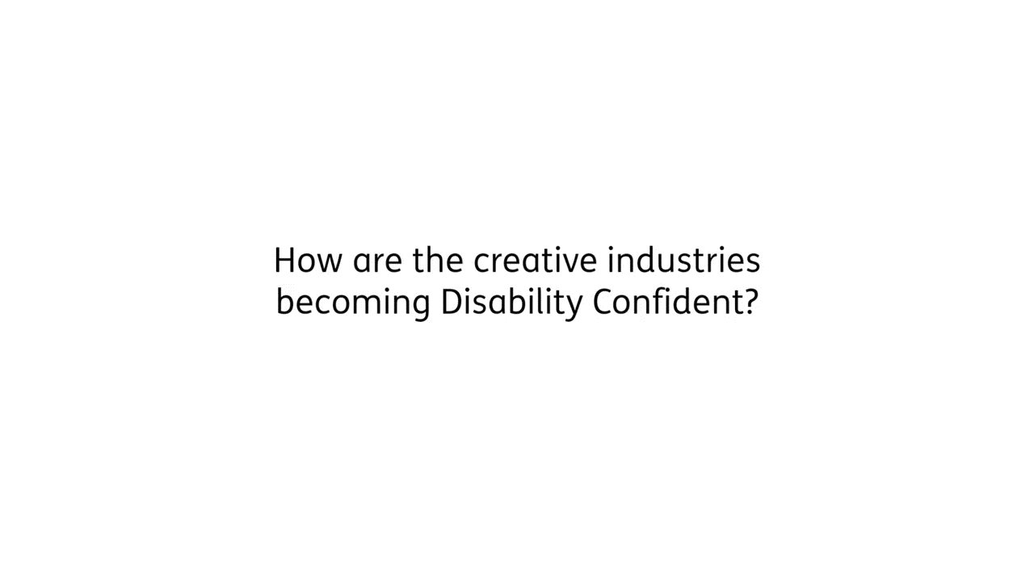

Slide 8
Real world example 2
The Lloyds Banking Group is also one of our Disability Confident Level 3 Leaders. In this video we hear from two Lloyds employees (Lewis & Ross) about their experience of Disability Confident.

Slide 9
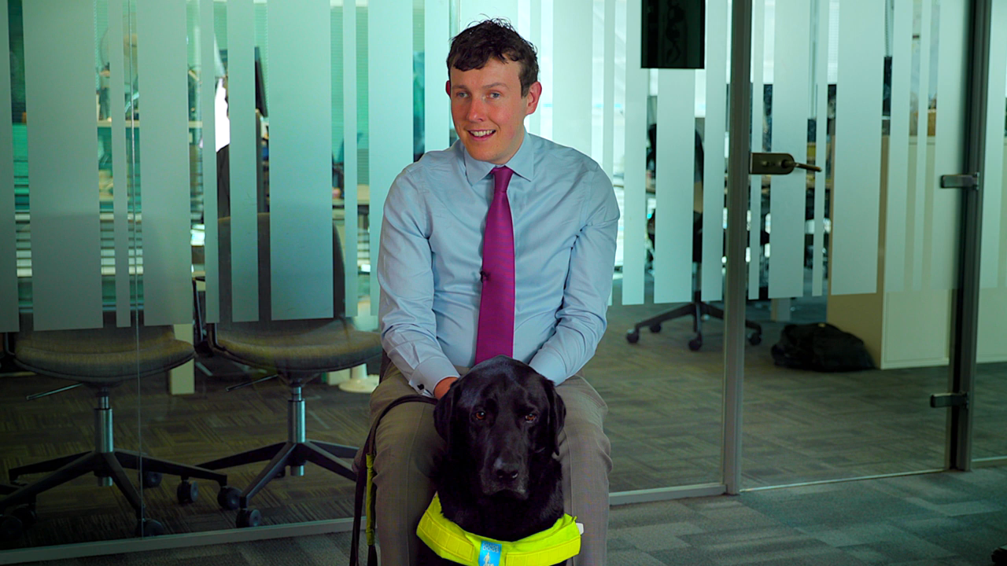

Slide 10
Real world example 3
Marks & Spencer have also signed up to be Disability Confident. Here we hear from Anthony and his manager about the difference Disability Confidence has made to him and his family.

Slide 11
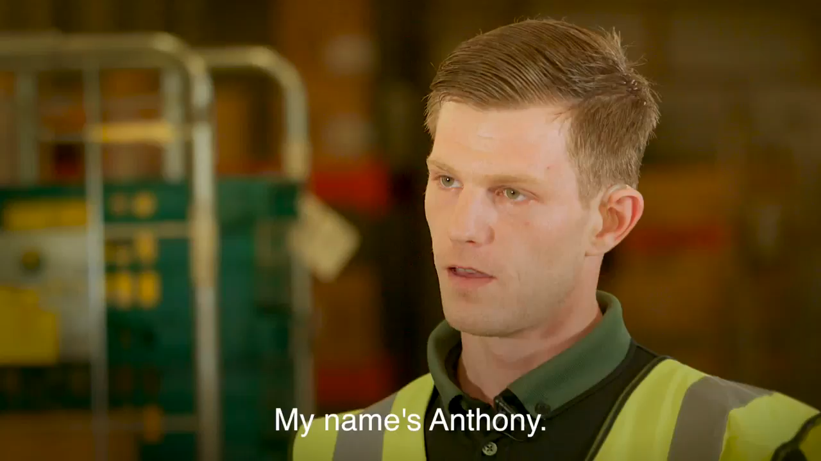

Slide 12
What’s in it for the employer?
Good question, we’re glad you asked…
There are 7 million people in the UK at working age with either a long-term health condition or class themselves as disabled. Each one of them has unique skills and a fresh perspective to bring to a company.
Some employers have found that employing someone with a disability gives them a real sense of loyalty to the company that believes in them. This is turn promotes hard work and a sense of fairness amongst all staff.
A 2014 report from Oxford Economics found that some employers face costs of up-to £30,000 to retrain employees when vacancies become available. Retaining existing employees when the become disabled could lead to huge savings.
The Purple Pound is a term often used to describe the spending power of disabled people and their friends and families. Companies could access the spending power of disabled people which the government estimates is approximately £249 billion per year!
This was demonstrated by Mars® in 2016 when they ran an inclusive marketing TV campaign. The following advert led to an increase of 8.1% whilst the ad was running.

Slide 13
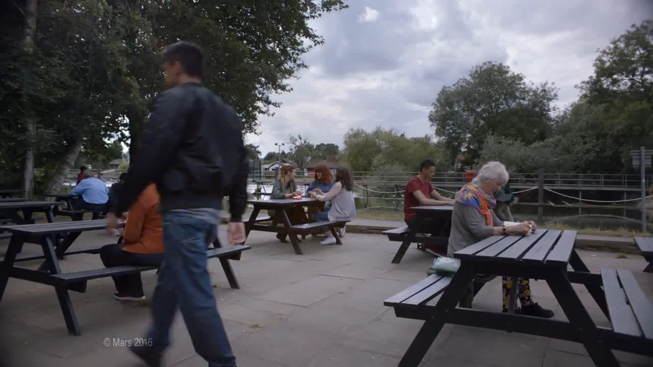

Slide 14
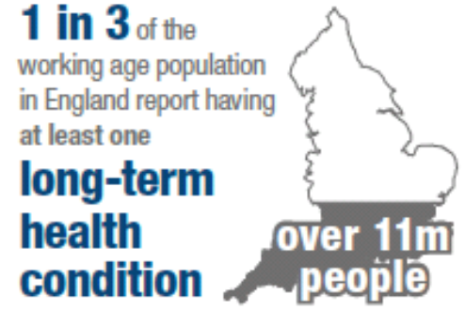
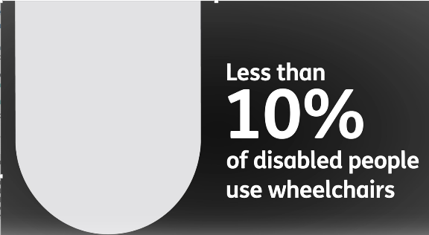
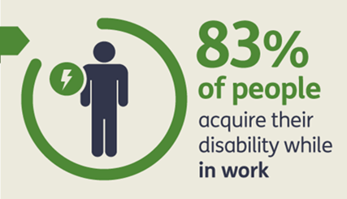
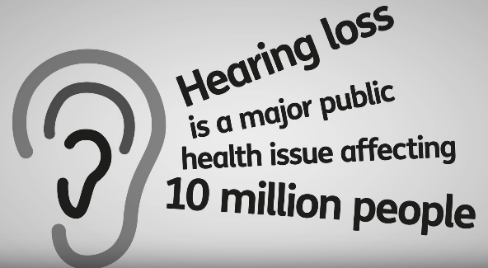
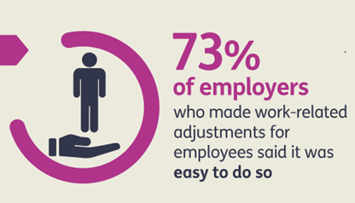
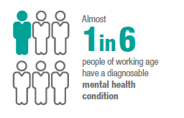
Did you know?

Slide 15
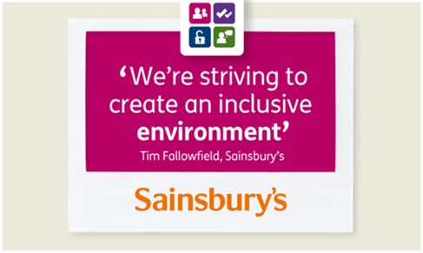
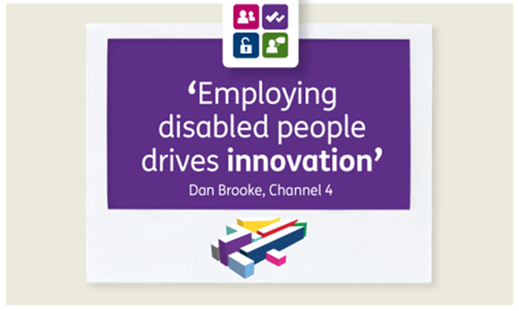
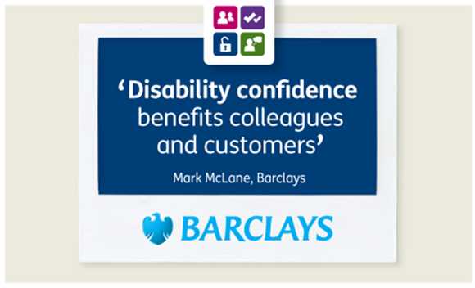
Leading from the front
Whilst 67% of businesses said they understand the benefits of a workforce that reflects their customer base*, a recent study found that just 8% of recruiters had recruited someone with a disability or long term health condition in the last year**.
The scheme can help to translate those good intentions into action and show your associates that you have inclusive values.
*Design with the end in mind Employer segmentation study, 2009
** Department for Work and Pensions. Employer Engagement and Experience Survey; 2013

Slide 16
How does it work?
The Disability Confident scheme has three levels.
These are designed to support you on your Disability Confident journey.
Each level must completed before moving on to the next.
The best part…. IT’S FREE to sign up
Level 1
Level 1 is simply signing up with your commitment and starting your Disability Confident journey

Slide 17
How does it work?
The Disability Confident scheme has three levels.
These are designed to support you on your Disability Confident journey.
Each level must completed before moving on to the next.
The best part…. IT’S FREE to sign up
Level 2
The two themes of Disability Confident are;
Getting the right people for your business
Keeping and developing your people
To achieve Level 2, an employer will be asked to provide examples of how they are achieving these two themes

Slide 18
How does it work?
The Disability Confident scheme has three levels.
These are designed to support you on your Disability Confident journey.
Each level must completed before moving on to the next.
The best part…. IT’S FREE to sign up
Level 3
Level 3 involves acting as a champion within your local and business communities.
An assessment of the employer’s Level 2 criteria would also need to take place

Slide 19
Where to begin?
To join Level 1, employers should visit the website below and fill out the sign-up form.
Employers will need to provide the following information in order to join Level 1.
  provide their business details
  sign up to the Disability Confident commitments, which include having inclusive recruitment processes and providing reasonable adjustments to support disabled employees
  identify at least one thing that they can do that will make a difference for disabled people, such as;
Work Experience
Job Shadowing
Internships
Apprenticeships
Work Trial
Traineeships
Paid Employment
Student Placements
Sector-based work academy placements
www.Gov.uk/disability-confident

Slide 20

Where to begin?
Once signed up, the employer will receive an accredited certificate in recognition of their commitment, as well as logos and promotional material that they can use on websites and ads.
Employers also have access to the Disability Confident Website;
www.gov.uk/disability-confident/
Here they will find guidance on employing disabled people and people with health conditions and:
Guidance & Support
Webinars & workshops
Information about potential funding
Peer support groups on social media platforms

Slide 21











How can you help?
Your work with our pool of employers is vital to the success of the disability
confident scheme. As you’ve seen we are off to an amazing start with
some big names already signed up including
some local ones;
We now need you to become confident in talking about the scheme with all the employers you interact with daily.
We’ve targeted ourselves on getting one million more disabled people into work by 2027. We know we can achieve it.
Will you help drive change?

Slide 22
Will you help?
Selling skills
Support for customers
Belief in the scheme
Real life examples
Friends & family

Slide 23
Will you help drive change?

